Slide 1
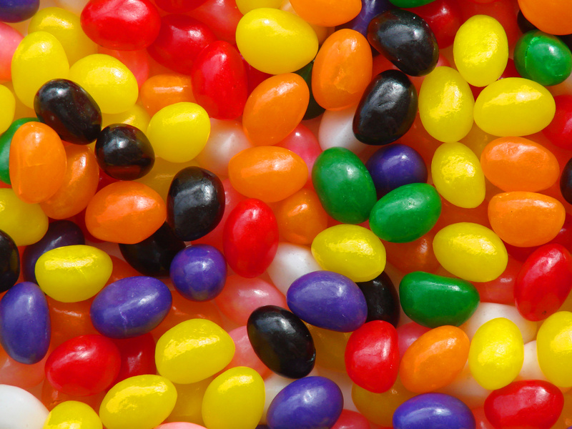
Unit #2 Colour
        THE COLOUR WHEEL
        COLOUR SCHEMES
        COLOUR AND VALUE

Slide 2
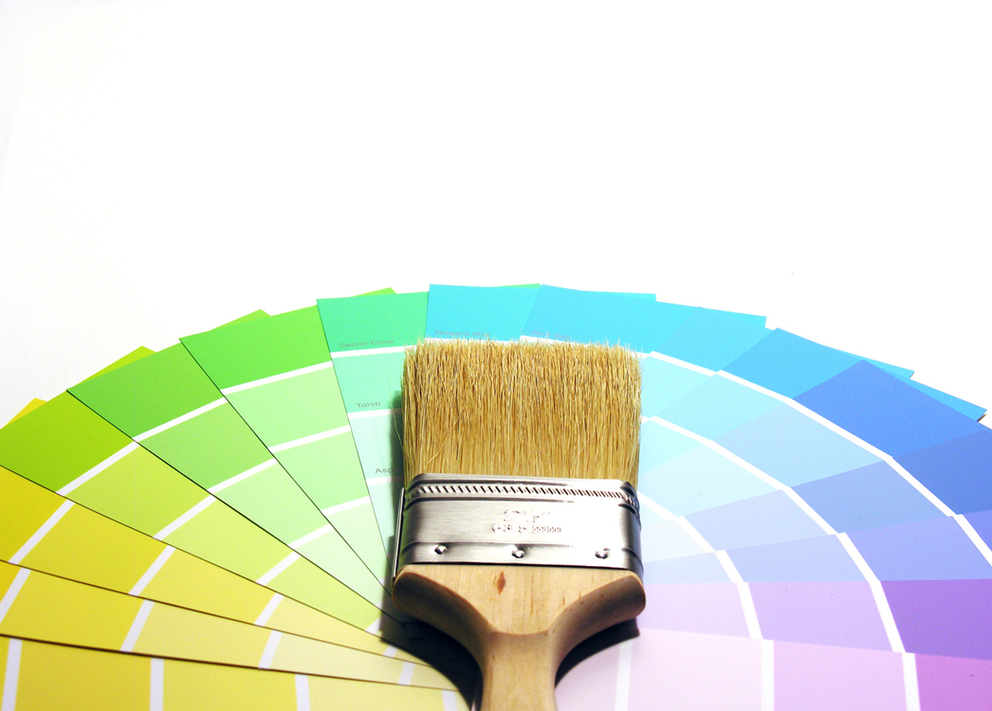
THE COLOUR WHEEL
Terms
Hue: The name of a Colour in the Colour Spectrum
Primary Hues: Red, Yellow, Blue
-You cannot make the primary hues by mixing other colours together but by combining the 3 primary hues and black and white, you can create EVERY OTHER COLOUR

Slide 3
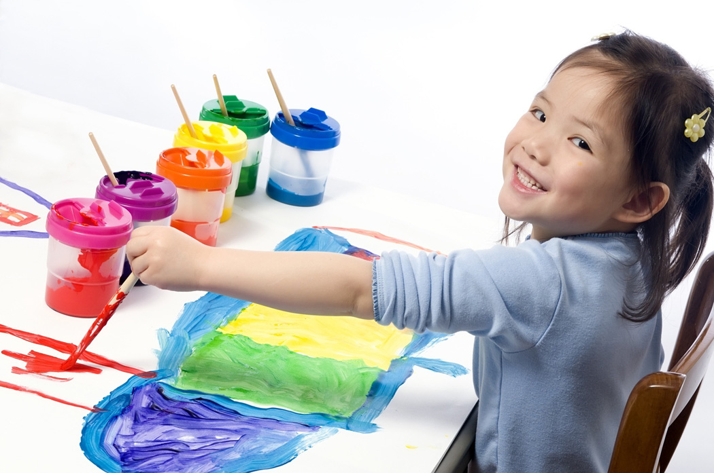
Secondary Hues: Made by mixing 2 primary colours
Red + Yellow = ORANGE
Red + Blue = VIOLET
Blue + Yellow = GREEN
The 3 Secondary Hues are ORANGE, VIOLET, and GREEN

Slide 4

Why do we need a colour wheel?
THE COLOUR WHEEL: The Spectrum Bent into a circle
-a tool for organizing the 12 colours
-3 primary, 3 secondary, and 6 intermediate colours

Slide 5
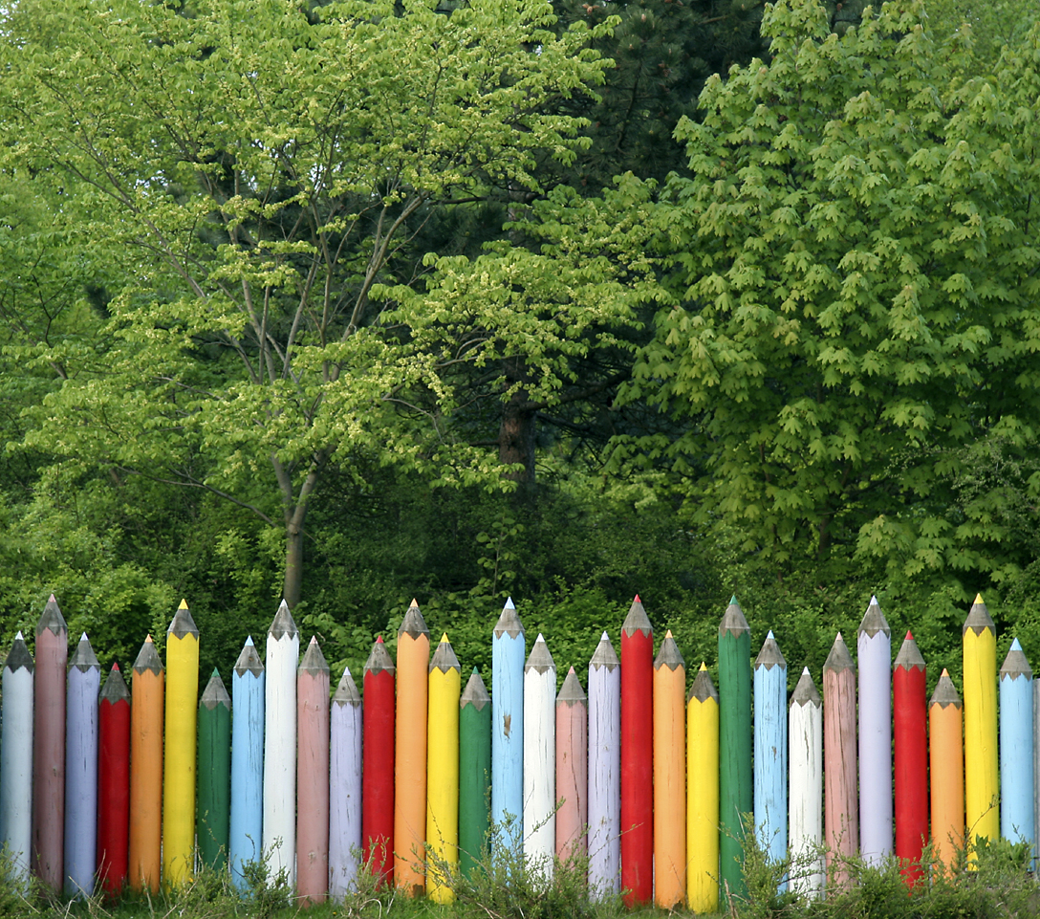
Complementary Colours:
The strongest contrast of a hue is produced by its complementary colour
Red’s strongest constrast = GREEN
-these colours combined catch the viewer’s eye
-they are opposite on the COLOUR WHEEL

Slide 6
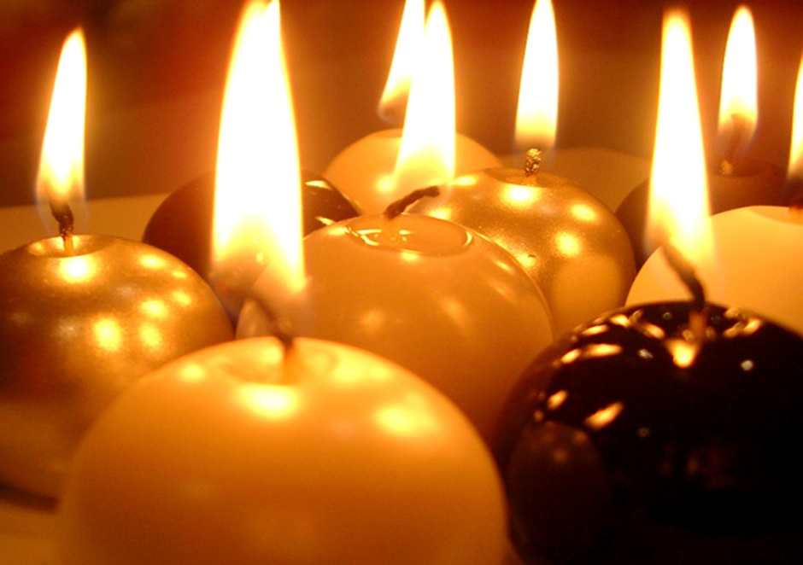

WARM vs. COOL COLOURS
Warm Colours = RED, ORANGE, YELLOW
Cool Colours = BLUE, GREEN, VIOLET
Viewer associates these colours with warm and cool objects
* The colour wheel is split into warm and cool colours

Slide 7
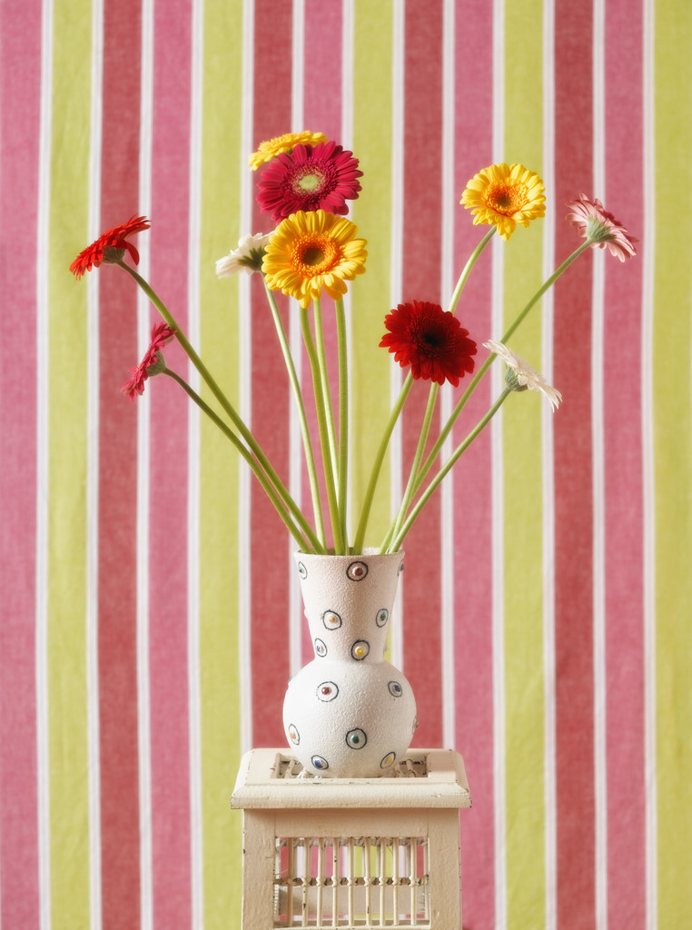
COLOUR SCHEMES
Colour Schemes: A plan for organizing Colours
-when 2 colours come in direct contact, their differences are more obvious
-colour schemes organize colours according to their relationship on the colour wheel
-allow you to avoid putting colours together in an unpleasant way

Slide 8

Most Frequently Used COLOUR SCHEMES:
MONOCHROMATIC COLOURS: (monochrome means one colour)
A Monochromatic Colour Scheme is one that uses one hue and tints and shades of that hue
Limited Scheme = Strong unifying effect on design
ANALAGOUS COLOURS: Colours that sit side by side on the colour wheel and have a common hue
Example: Violet, Red-Violet, Red, Red-Orange, and Orange (ALL HAVE RED IN COMMON)
A Narrow Scheme would be one limited to 3 hues
example: Violet, Red-Violet, Red
An Analogous Colour Scheme creates a design that ties one shape to the next using a common colour

Slide 9
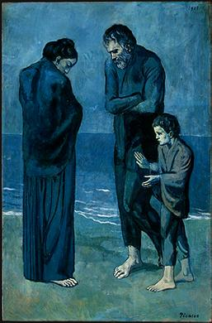
What type of Colour Scheme is this?

Slide 10
Artist: Picasso
Title: The Tragedy
Does the Painting Evoke the Feeling of the Title?
Why or Why Not?

Slide 11
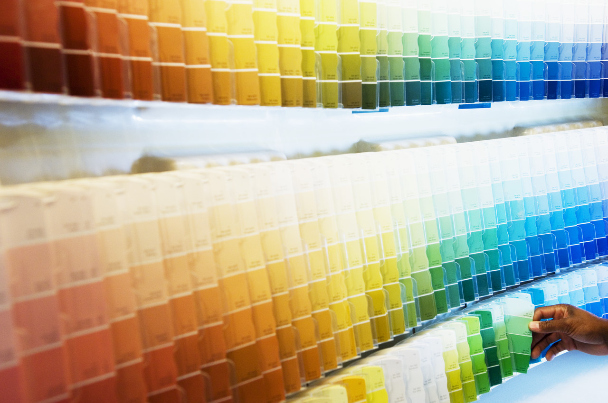
VALUE
Value: the art element that describes the lightness or darkness of a colour
(the amount of light a colour reflects determines its colour value)
Yellow is the lightest hue (reflects the most light)
Violet is the darkest hue (reflects the least light)

Slide 12
NEUTRAL COLOURS
BLACK, WHITE, and GRAY = NEUTRAL COLOURS
White Objects: reflect ALL of the colours (do not absorb ANY)
Black Objects: absorb all the Colours (does not reflect ANY light)
Gray = Impure White
(it reflects an equal part of each colour wave)

Slide 13

CHANGING THE VALUE:
You can change the value of any HUE by adding Black or White
-A Light Value of a Hue is called a Tint (to create, add White)
-A Dark Value of a Hue is called a SHADE (to create add Black)

