Slide 1
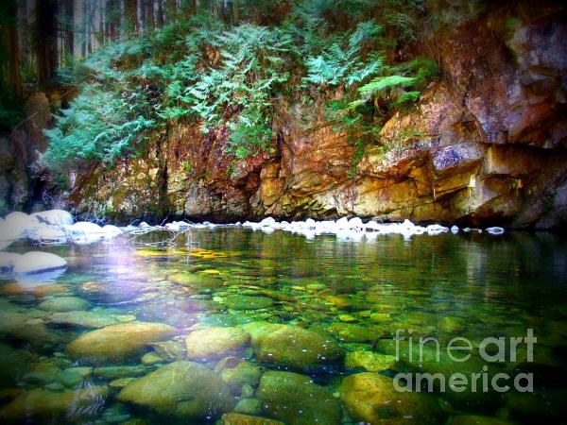
The Capilano River and the Coast Salish People
Art 8 : WATER PROJECT

Slide 2
THE CAPILANO RIVER:
Flows North to South through Coast Mountains on the North Shore
Empties into Burrard Inlet
1 of 3 primary water sources for Greater Vancouver
The Cleveland Dam was built in 1954 to create a reservoir to store the water
The river has a historic Salmon Run which was impacted by the dam (a hatchery was built downstream to aid in the survival of the run)
The river flows through the Coastal Rainforest and through a steep canyon in its lower section

Slide 3
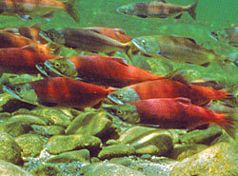
Apart from a water supply, the Capilano River provides food to many people…
Q: Historically, can you think of who might have relied on the Salmon from the river as a primary source of food?
A: British Columbia’s Coast Salish People

Slide 4
The Capilano Indian Reserve:
The Capilano Indian Reserve is one of the oldest communities in the Squamish Nation (part of the Coast Salish Ethnic and Lingquistic Group)
The Name of the Village “Xwemelch'stn”, translates to "Fast Moving Water of Fish", relating to the Capilano River
The archaeological evidence of Coast Salish occupation of this land dates back 12000 years.
The Salish harvested salmon and coastal shellfish as their nutritional mainstay (supplemented with deer, elk, moose, bear, migratory birds, medicinal plants, roots, herbs, and berries)
How would these people survive without the Salmon Run from the Capilano River?

Slide 5
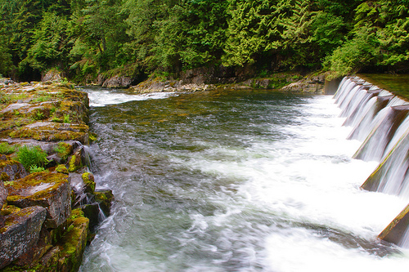
The Fish Hatchery…
As mentioned earlier, the Hatchery was built to help the Salmon survive after the dam was built in 1954
It’s purpose was to rear and release the diminishing stock of both Coho Salmon and Steelhead Trout.
The hatchery is an ideal environment for visitors to learn about the lifecycle of salmon.

Slide 6
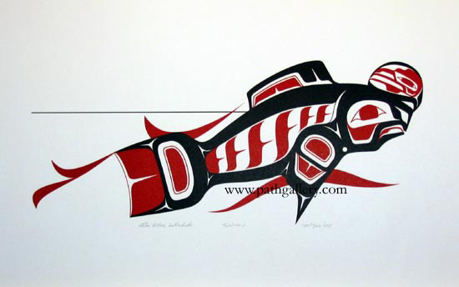
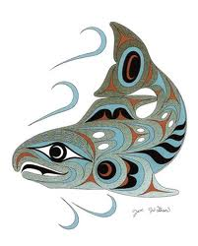
As seen in their artwork, the Salmon were a huge part of Coast Salish Life…

Slide 7
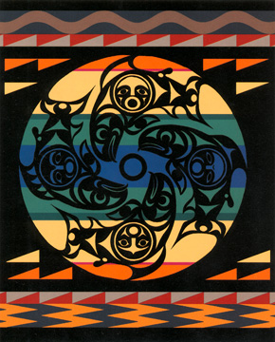
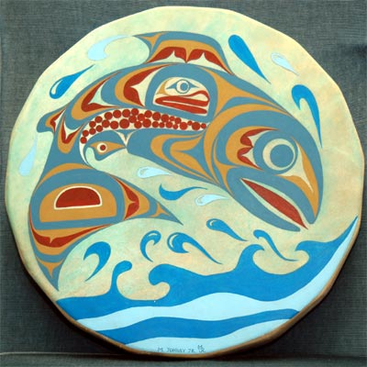
Can you spot any similarities?

Slide 8
Get out your Sketchbooks…
WHILE YOU WATCH THIS VIDEO, USE YOUR SKETCHBOOK TO DOCUMENT THE COMMON SHAPES USED IN COAST SALISH DESIGN
(yes- DRAW THEM!)
http://Typical Shapes used in Coast Salish Design

Slide 9
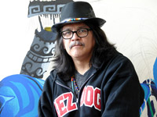
Meet Lawrence Paul Yuxweluptun…
He graduated from Emily Carr School of Design in 1983 (Honours Degree in Painting)
He liked to document and promote change in contemporary Indigenous history in large
Scale Paintings
Used Coast Salish formal Design Elements
Paintings explore political, Environmental, and cultural issues-

Slide 10
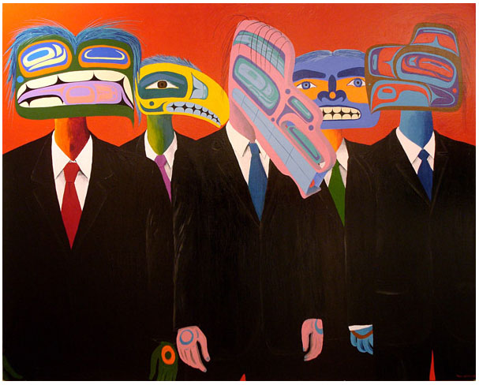
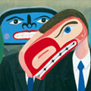
Lawrence Paul Yuxweluptun has created some of the most memorable painted images in the last quarter-century of Canadian artmaking.
Here are some examples:

Slide 11
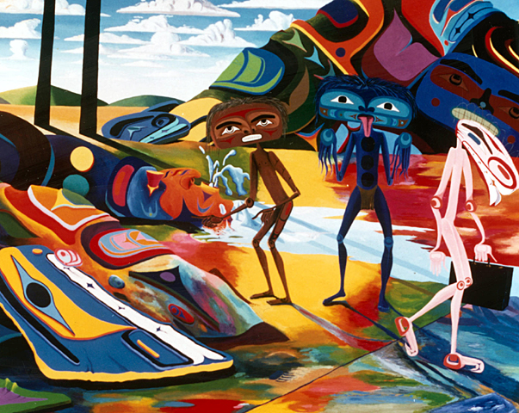
LPY combines Coast Salish design elements with Surrealism

Slide 12
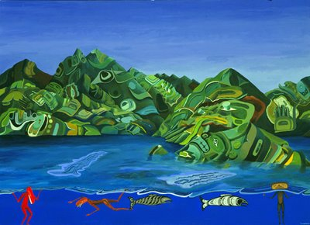
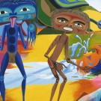
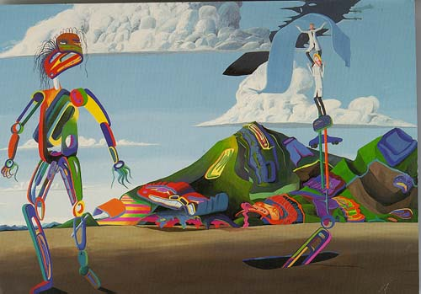
What do these works
have in common?

Slide 13
What are some of the Big idea behind LPY’s work?
suppression of First Nations cultures
the occupation and destruction of the natural environment
self-governance and the politics of land claim negotiations

Slide 14
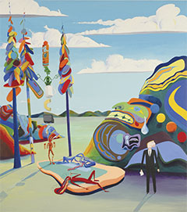
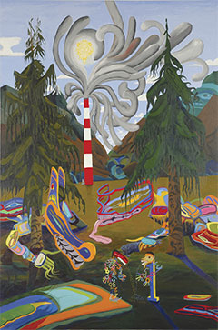

Slide 16
YOUR TASK:
Think about your opening Water Project talk
What were some of the big themes?
As Humans, what is our relationship with water?
How did water consumption affect us most recently?
In your Sketchbook using two FULL PAGES:
Create Visual Journal page that represents your relationship with water
What message might you try and convey? How will you accomplish this
You MUST use Coast Salish Design Elements within your piece
You may use ANY materials
You only have one class
>>>>> SEE VISUAL JOURNAL POWER POINT + EXAMPLES

