Slide 1
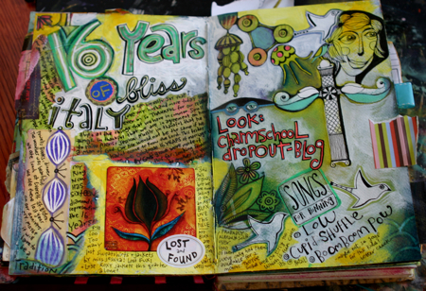
VISUAL JOURNALING

Slide 3
What is a Visual Journal?
It’s just that, a VISUAL journal that ILLUSTRATES thoughts, feelings, and ideas
It can combine texts with different materials and techniques to create a beautiful mixed media piece
It is often organic and a work in progress
Requirements: Two page spread, using and combining all of the principles of art and all of the elements, layer, layer, layer!

Slide 4
THE BEST ADVICE: Start with your background…and layer, layer, layer!!
Some possible ideas for your first layer:
--Do an inkblot with thinned acrylic paint and then paint or draw over it. Let the blot be your inspiration.
--Splatter or drip paint.
--Sponge paint with acrylics.
--Start your page with a map.(create your own map. Where are you going?)
--Paint a watercolor wash on drawing paper and texturize it with wadded up paper or plastic wrap. Use this paper once it dries as a background for a spread or as collage additions on other spreads.
--Scratch into wet paint or do a finger painting across a page.
--Paint thin layers of color
--Draw or paint with unconventional tools
--Add sand to acrylic paint and cover the page before you start painting or drawing your image
--Stain watercolor paper with acrylic or tea and create an antique image- glue this the page
--Before you being painting, use highlighter or circle words that form a thought and layout your design --Use aluminum foil to make a cool background, then collage interesting pictures to it

Slide 5
Here are some examples:

Slide 19
Some helpful videos:
This video is an excellent example of layering, but turn the sound off, as it sounds like aliens are invading…no seriously!
https://youtu.be/5_cy4MExgrc
Here’s another (ignore the product plug):
https://youtu.be/k-IgqmqIH-Q
Textured backgrounds:
https://youtu.be/tf6pj_pYRoM

Slide 20
Your Task:
Every two weeks, you will be creating a weekly visual journal on a changing theme (this will be homework)
Each week’s theme will be determined by a different member of your class
The only criteria you must follow, is that the visual journal must be at least one full page in your sketchbook (the first assigned journal might require a double page) and must include the following:
Text (of some type)
Collage
Observational drawing
The rest is up to you! HAVE FUN, EXPERIMENT, TAKE RISKS ☺

