Slide 1
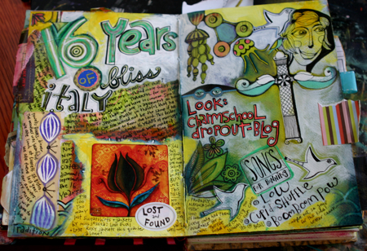
VISUAL JOURNALING

Slide 3
What is a Visual Journal?
It’s just that, a visual journal that illustrates thoughts, feelings, and ideas
It can combine texts with different materials and techniques to create a beautiful mixed media piece
It is often organic and a work in progress
Requirements: Two page spread, using and combining all of the principles of art and all of the elements, layer, layer, layer!

Slide 4
Step 1: Start with a background (this is your base layer) Things you might try…
--Do a page with a border-color black and white
--Do an inkblot with thinned acrylic paint and then paint or draw over it. Let the blot be your inspiration.
--Splatter or drip paint.
--Sponge paint with acrylics.
--Start your page with a map.(create your own map. Where are you going?)
--Paint a watercolor wash on drawing paper and texturize it with wadded up paper or plastic wrap. Use this paper once it dries as a background for a spread or as collage additions on other spreads.
--Scratch into wet paint or do a finger painting across a page.
--Paint thin layers of color
--Draw or paint with unconventional tools
--Add sand to acrylic paint and cover the page before you start painting or drawing your image
--Stain watercolor paper with acrylic or tea and create an antique image- glue this the page
--Before you being painting, use highlighter or circle words that form a thought and layout your design --Use aluminum foil to make a cool background, then collage interesting pictures to it

Slide 5
Here are some examples:

Slide 15
Some helpful videos:
This video is an excellent example of layering, but turn the sound off, as it sounds like aliens are invading…no seriously!
https://youtu.be/5_cy4MExgrc
Here’s another (ignore the product plug):
https://youtu.be/k-IgqmqIH-Q
Textured backgrounds:
https://youtu.be/tf6pj_pYRoM

