Slide 1
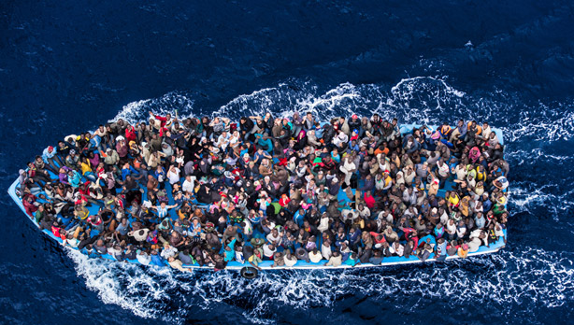
Syrian Refugee Crisis
Photograph: Massimo Sestini/eyevine

Slide 2
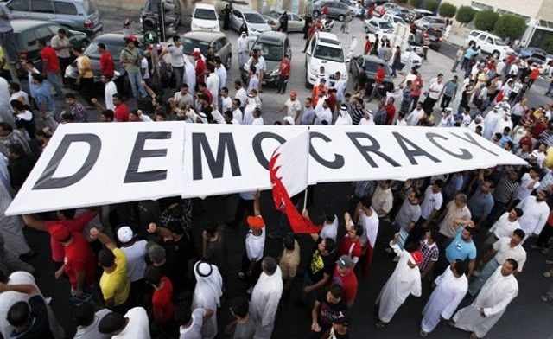
Protests for democracy in the Middle East, 2011
Photo taken by Getty.

Slide 3
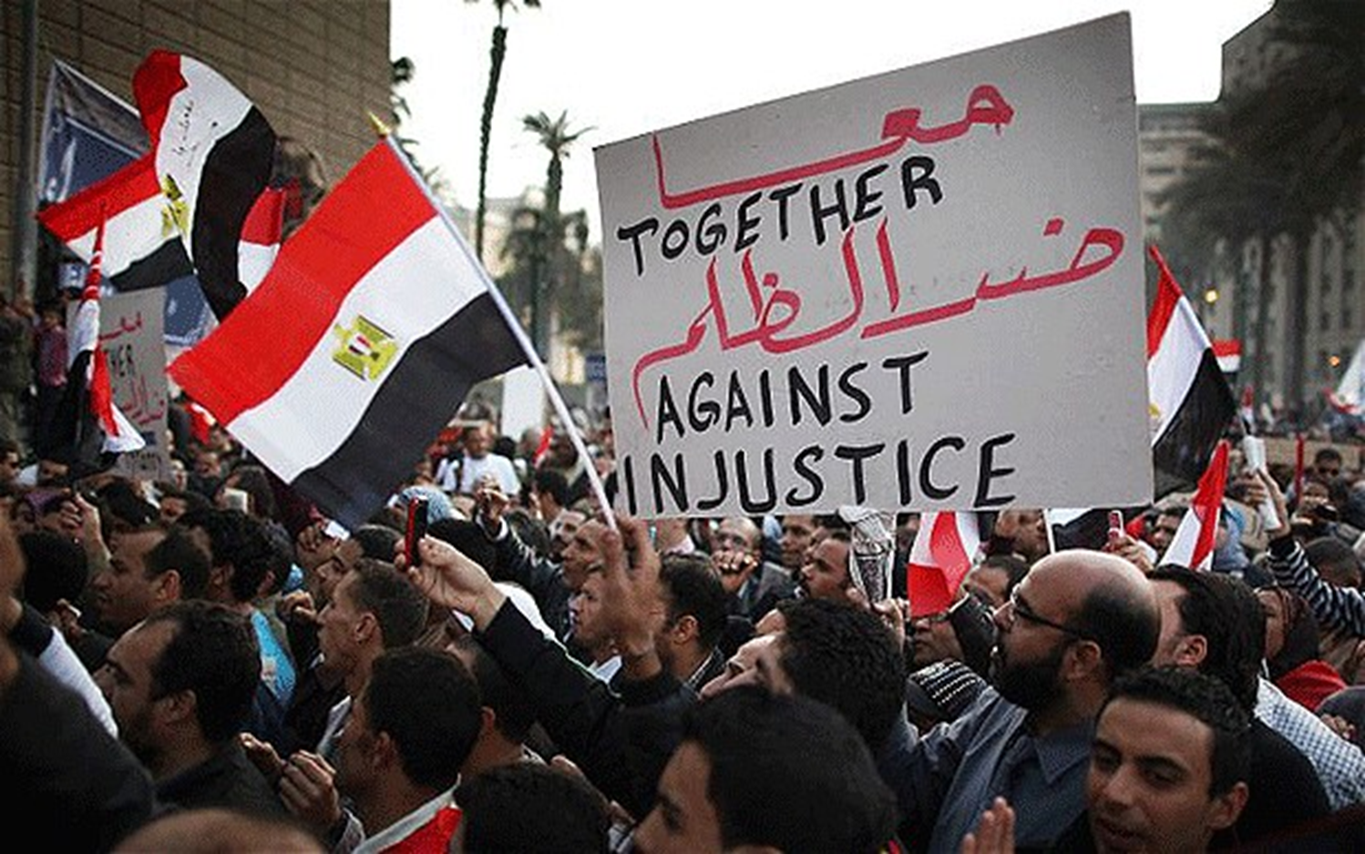
Protests for democracy in the Middle East, 2011
Photo taken by Reuters

Slide 4
Map of Syria and the Middle East
Map by Wikipedia

Slide 5
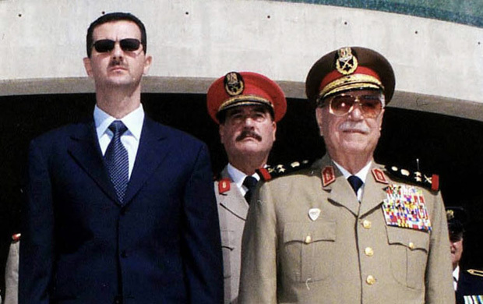
Assad
Syria’s Dictator: Bashar al-Assad
Photo by the AP

Slide 6
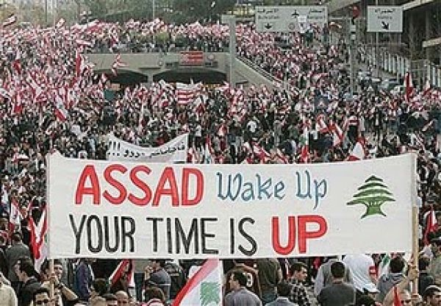
Protests for democracy in Syria, 2011

Slide 7
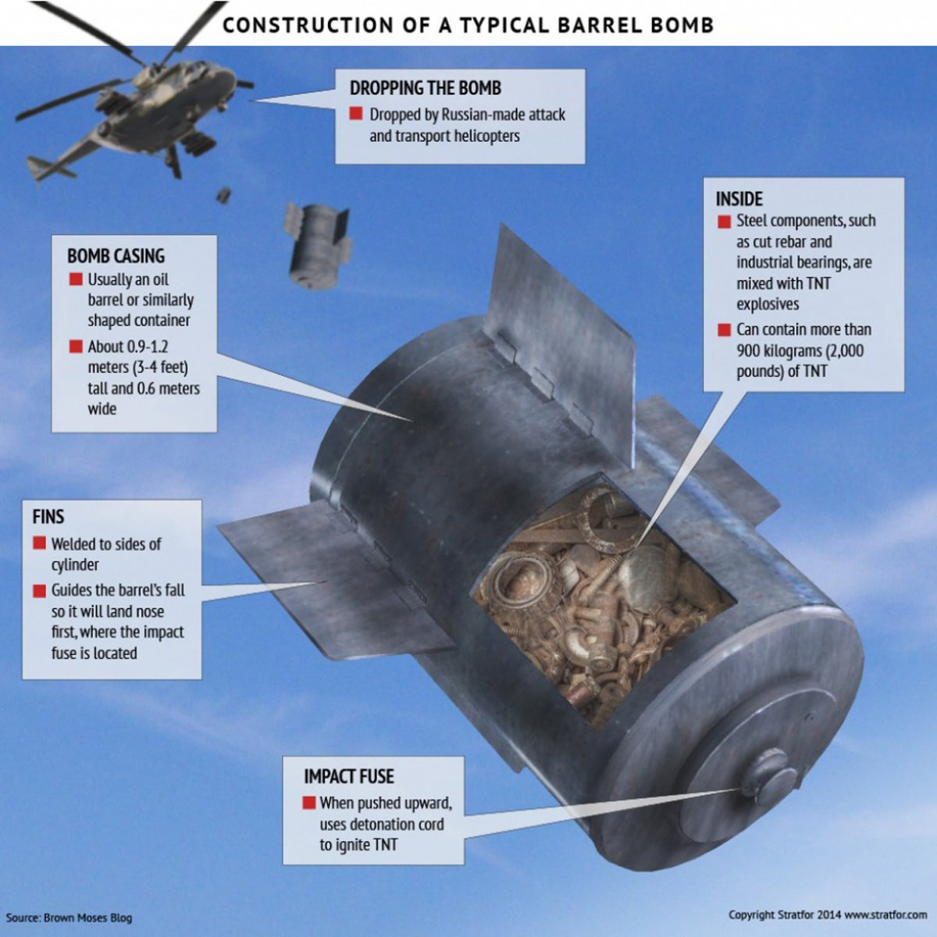
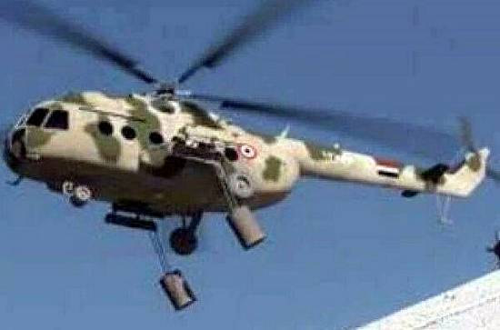
Barrel Bombs his forces drop on citizens
Video

Slide 8
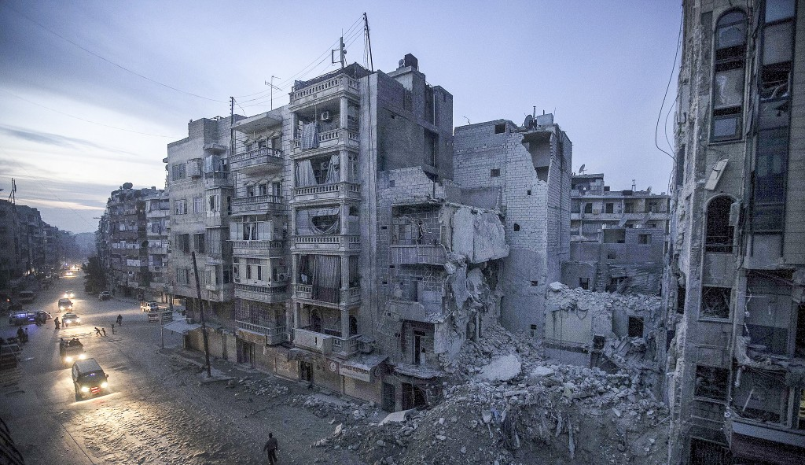
2011-to the present:
Assad destroys many Syrian cities to fight back against protesters
Photo by Freedom House

Slide 9
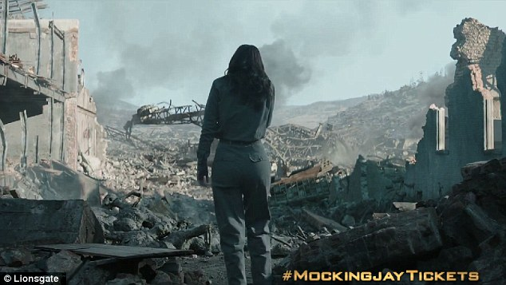
His actions were similar to what you may have seen in “The Hunger Games”

Slide 10
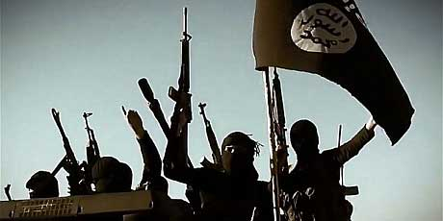
To make matters even worse:
ISIS—or the Islamic State-- seeks to control Syria, Spring 2014

Slide 11
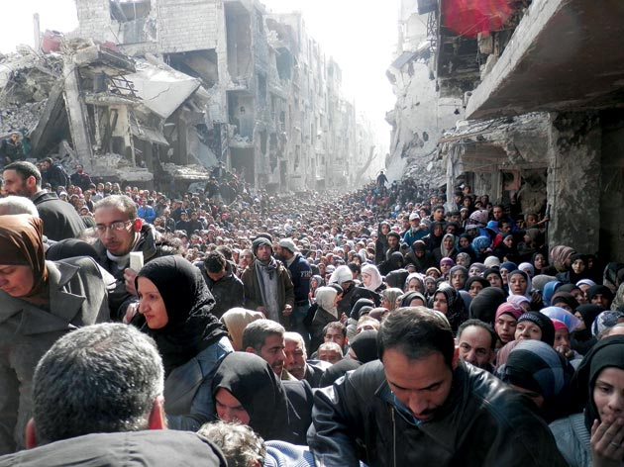
A flood of refugees attempting to escape Syria, 2011-present
Photo by Getty Images

Slide 12
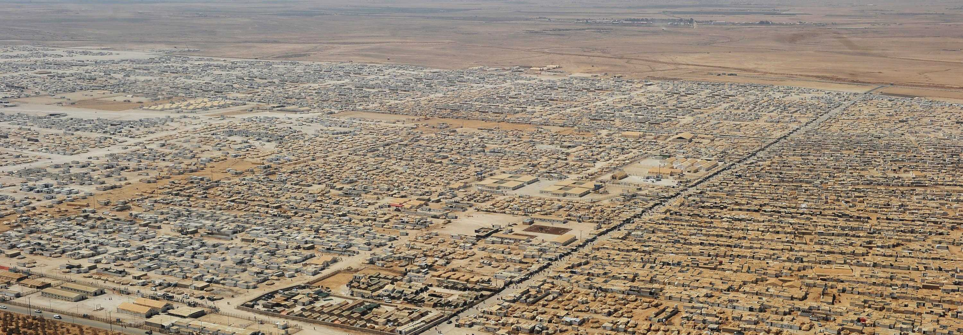
Zaatari Refugee Camp in Jordan, i
Many Syrians fled to refugee camps in neighboring countries
U.S. State Dept. photo

Slide 13
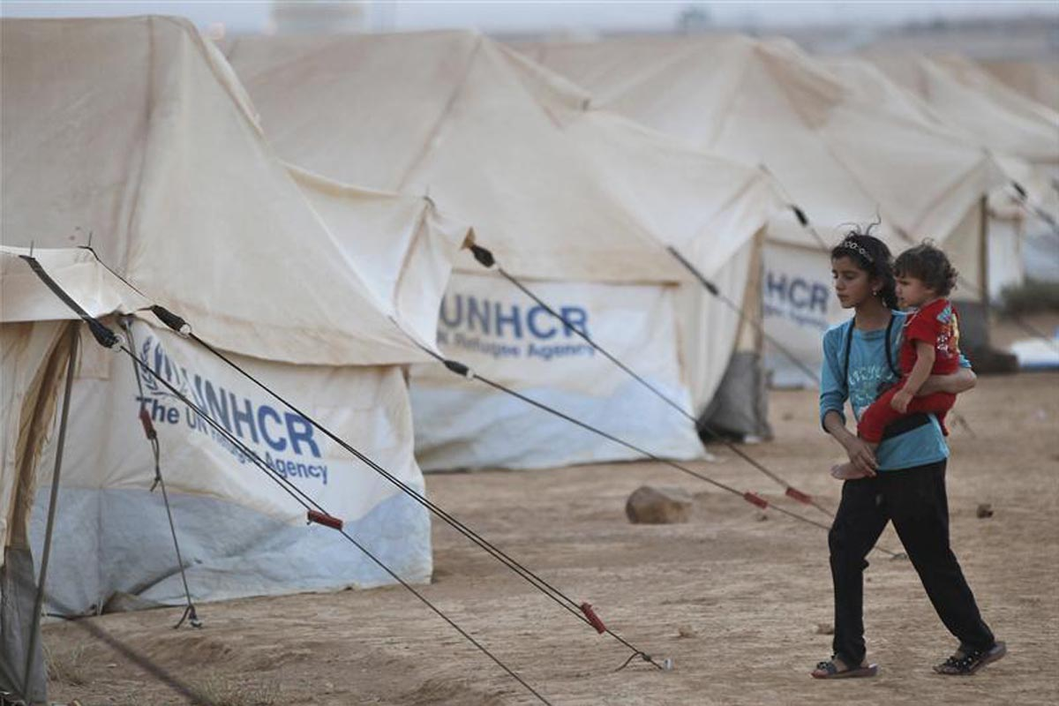
Two Syrian children in a refugee camp
Photo by Reuters

Slide 14
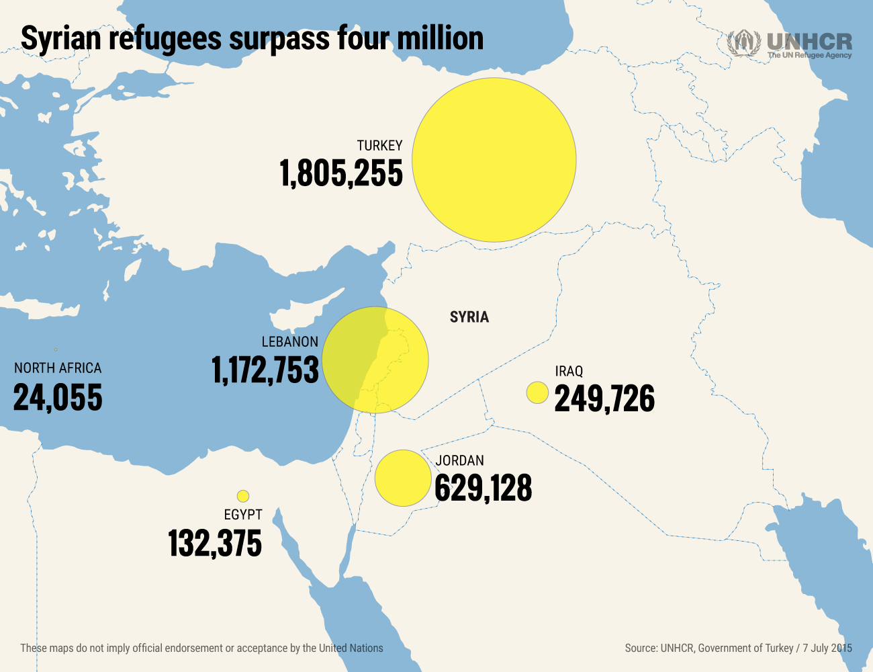

Slide 15
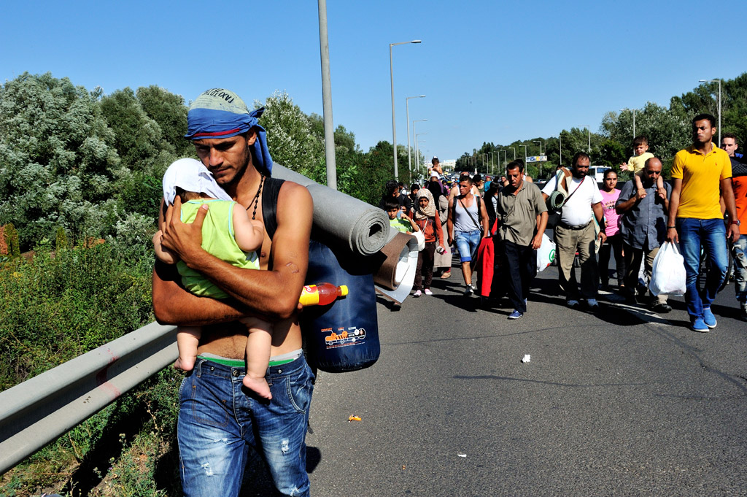
2015: Thousands of Syrians attempt to leave to Europe
Photo by the United Nations

Slide 16
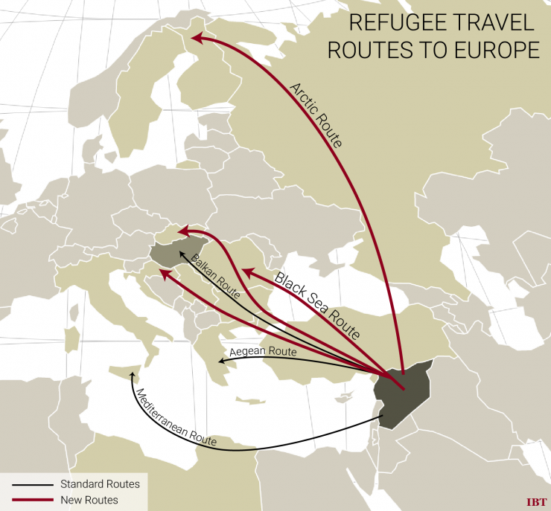
Map created by the International Business Times--
Syria

Slide 17
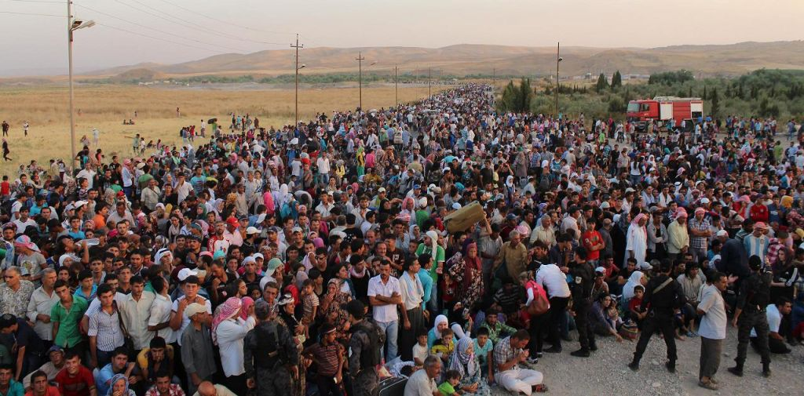
These people are seeking protection in Europe known as Asylum

Slide 18
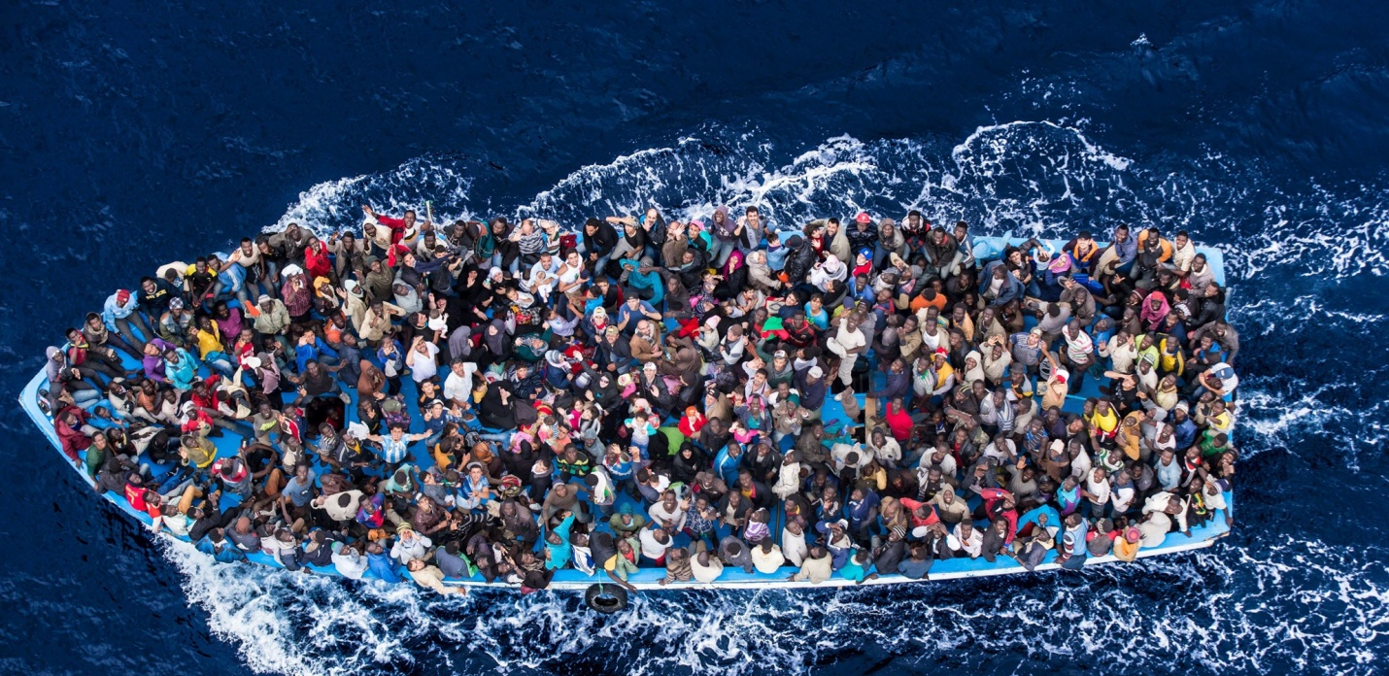
Many have risked dangerous boat rides across the Mediterranean Sea
Photo by Massimo Sestini- Polaris

