Slide 1
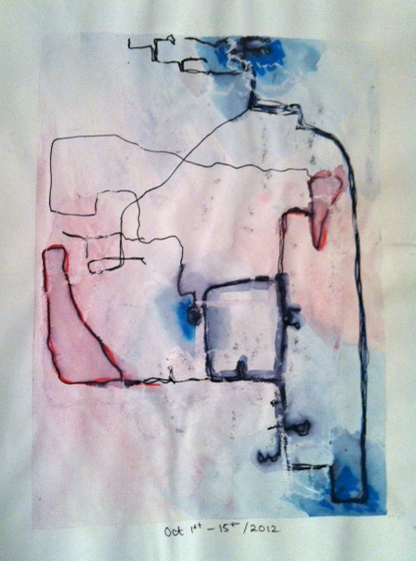
Place and Belonging:
…a large portion of our learning is derived from our own experiences in place. “What binds us to places and the life of a place determines a degree of our being in the world” Cannatella (2007, p. 632).

Slide 2
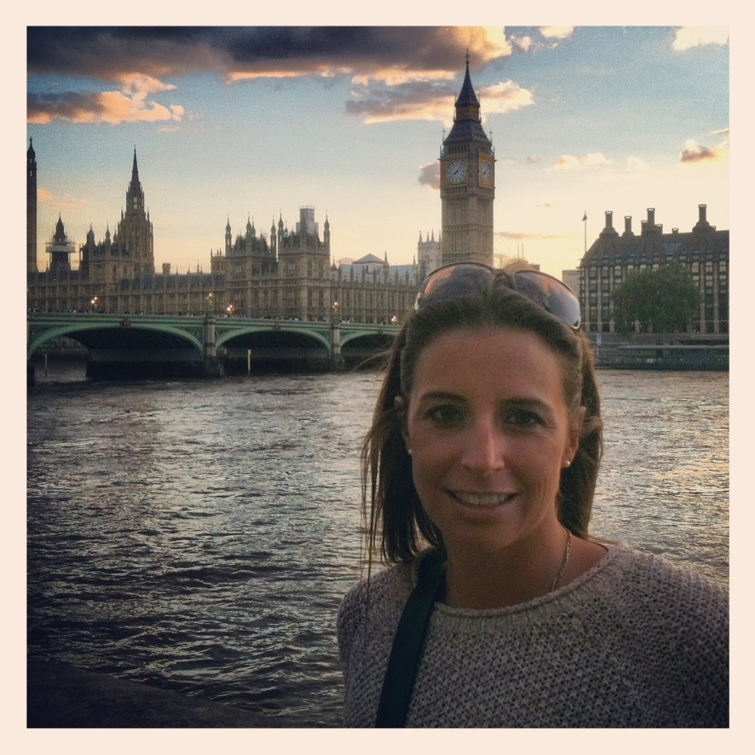
“The places we inhabit physically, emotionally and cognitively…help to form an essential aspect of our phenomenological selves.”
Phenomenology: The study of the structures of experiences and consciousness
As I continued to discover the new environment that was London, my heightened awareness of geographical location, personal identity, and questioned sense of belonging quickly became recurring themes of personal exploration

Slide 3
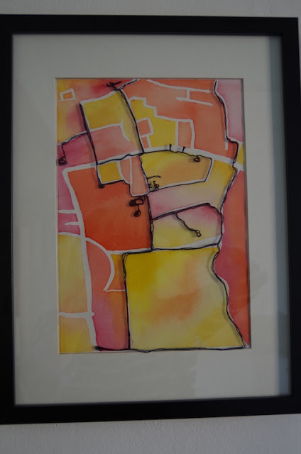
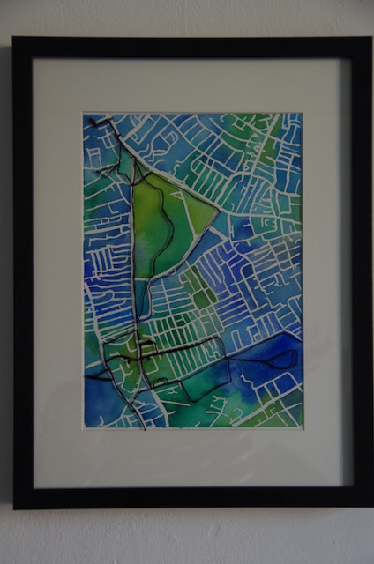
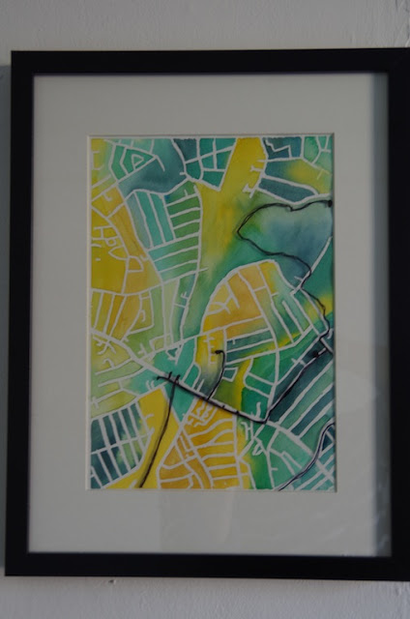
Why was I interested in this?
-I was exploring a new city, so was constantly lost, and very aware of the point when these places became more familiar
-I was aware of my expanding footprint. What do I mean by that?
-I was really aware of my surroundings because of my own stress fracture
-I stood out like a sore thumb because of my accent, so was very aware that I didn’t belong
-Different things would happen that would make me feel as though I fit in
-I began to learn the ‘unspoken rules’ of the city. What were they? Are there unspoken rules in Canada? What about Vancouver?

Slide 4
Why Map?
Language of maps is filled with artistic potential
Cartographers have long known that deploying artistic skills in a map can enhance it’s effect (use creativity to make maps more compelling)
Since the 60s there’s been exponential increase of artists working with maps
Maps act as a statement for politically imposed boundaries
Maps call out differences between collective knowledge and individual experience ***
Some artists map to find personal orientation
Artists rip, shred, slice, carve, and dissect maps
They fold, trace, weave, crumple, burn, twist, tear, and stitch them
Some have mapped their sweat, others the folds of their skin
Artists who map are speaking in an understandable language
Traditional maps point the way to a new place, but artworks can embody the experience of that place **
A map can be a form of documentation of a lived experience in a place

Slide 5
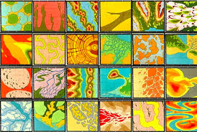
Artists who map:
Lordy Rodriguez maps places he’s been and yearns to go back to.

Slide 6
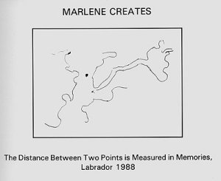
Marlene Creates makes hand-drawn maps, believing that land has personal significance, molding the way we see ourselves
Like these artists, my own work resembled a scrapbook of sorts, recording significant moments in my life, and depicting them visually

Slide 7
Ruth Watson (2009, p. 303) describes the recent shift away from artists manipulating images of a map, to using the map to relay a political message or tell a forgotten story.

Slide 8
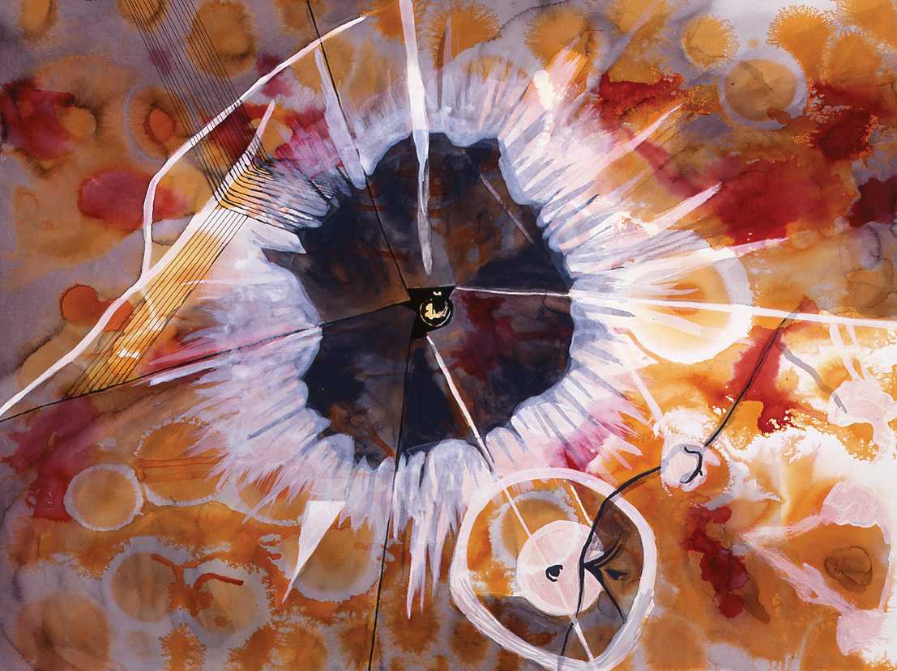
Elin O’Hara Slavick depicts an aerial view of the first atomic explosion in New Mexico

Slide 9
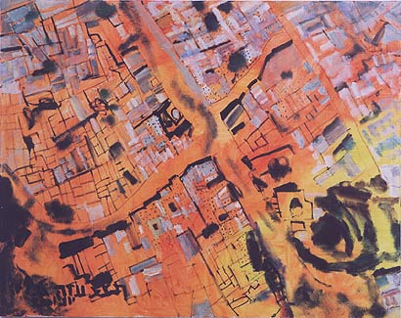
Nurit Gur-Lavy Karni paints an aerial photograph of the Gaza Strip ( a self-governing entity on the eastern coast of the Mediterranean Sea that borders Egypt on the southwest for 11 kilometres (6.8 mi) and Israel on the east and north along a 51 km (32 mi) border. Since 2007, the Gaza Strip has been de-facto governed by Hamas, a Palestinian faction claiming to be the legitimate representatives of the Palestinian National Authority and the Palestinian People. In 2012, the United Nations recognized the Gaza Strip as part of the State of Palestine )

Slide 10
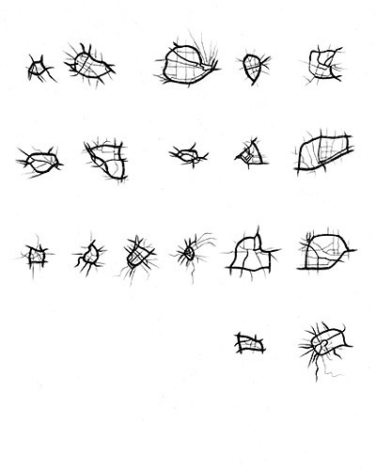
Jeff Woddbury City Hearts, 1999 Graphite on tracing paper

Slide 11
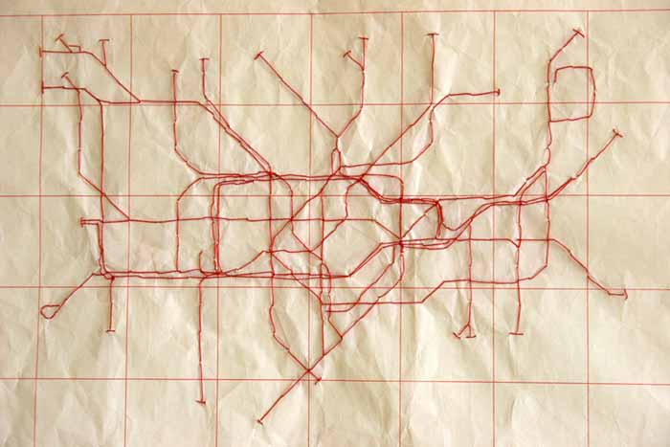
Susan Stockwell, London Subway, 2007 Red Cotton stitched on Calligraphy Rice paper

Slide 12
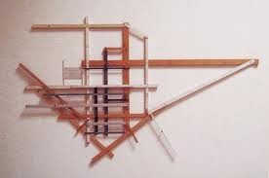
Greg Colson, Oildale, 2006 Enamel, ink, and pencil, on wood and metal

Slide 13
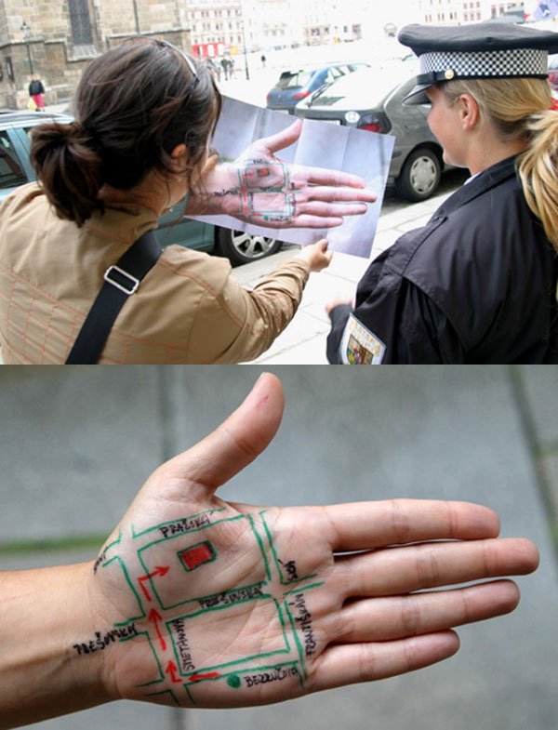
Yumi Janairo Roth Images from Meta Mapa, 2007

Slide 14
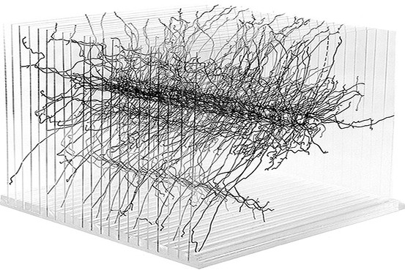
Karin Schaefer, WTC Memorial Model, 2003 Paint marker on Plexiglas (depicting the diverse stories of those who died in the attacks)

Slide 15
Your Task:
Tell the story of your own lived experience in an abstract conceptual artwork
A list of steps is on ‘The Art Smock’ website under Art 8 Blog

Slide 16
Some things to think about…
How will you tell your personal story?
Think about what alternative types of maps you might use (building floor plans, transport maps, trail maps, memory maps etc.)
Think about whether you will tape the four edges of your paper to achieve an even border
Will you use a pencil and a light table to transfer your ‘paths’ onto your good copy paper? Will you hand stitch your path? Is it a hand drawn map from memory? Or is there another way of telling your tale?
Medium: MIXED MEDIA OF YOUR CHOICE (acrylics /water colour / fine liner / water soluble marker /chalk pastel /prisma / oil pastel / collage / graphite / charcoal (HAVE FUN!, COMBINE MATERIALS, PLAY!!)
Limit your colour scheme! Will it be analagous? Warm? Cool? Completementary? Monochromatic?

Slide 17
Rules: (yes, there are a couple)
You may choose between two paper sizes (square or rectangle)
You may NOT use an actual map in your work except during observational drawing, or tracing
You as the artist are the cartographer ☺

