Slide 1
FOCAL POINT/ ‘ZOOM’
(In art and advertising)

Slide 2
FOCAL POINT: The element of a painting that pulls the viewer’s eye. Usually this is the center of attention. The Focal Point can be emphasized through the painter’s composition, specifically how they go about using the elements and principals of design in their work (use of colour, line, range of tones, pattern etc.) The Focal Point is usually the part of the artwork the viewer’s eyes are attracted to first.

Slide 3
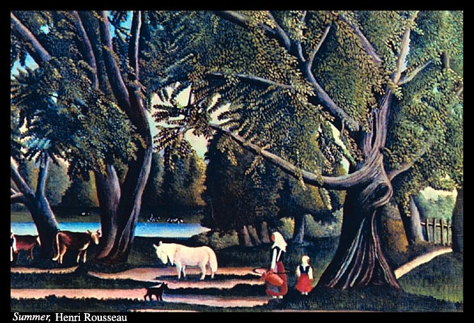
Where is the Focal Point in this image? Why?

Slide 4
VIEWFINDER:
A viewfinder is a simple yet extremely useful tool which helps you select and isolate particular elements in a scene to get the best composition.
IMAGE ISOLATION IN ADVERTISING: graphic designers often use the concept of isolated images or ‘zoomed’ images in order to sell a product. Can you find examples of ‘zoom’ in advertsing? Why is a close up or focused image more effective?

Slide 5
YOUR TASK:
Find 3 Magazine images and use a self made ‘frame’ to isolate a portion of the picture, making your own composition (see examples)
Trim the edges of the Magazine page and glue the entire page into your sketchbook, sign it, title it, and date it using a pencil
**Make sure to title the new piece correctly (See examples on wall at front of class)

