Slide 1
An Introduction to Charles Shulz
A Follow up on Personal Narrative

Slide 2
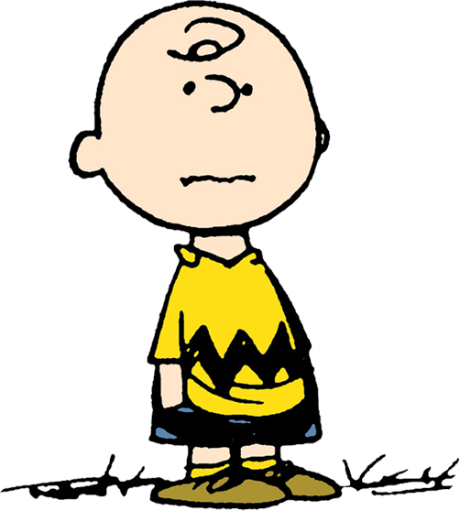
Charles Shulz
American Cartoonist, best know for the comic strip: The Peanuts
Main character of ‘The Peanuts’ was ‘Charlie Brown’ (Right)
Charlie Brown’s name came from a Colleague that worked with Shulz, but much about the character was inspired from Shulz’s own life

Slide 3
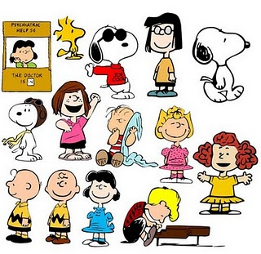
Similarities Between Shulz
and Charlie brown…
Like Charlie Brown's parents, Schulz's father was a barber and his mother a housewife.
Schulz admitted in interviews that, like Charlie Brown, he had often felt shy and withdrawn in his life.
Schulz reportedly had an intelligent dog when he was a boy. Although this dog was a pointer, and not a beagle as was Snoopy, family photos of the dog confirm a certain physical resemblance.
References to Snoopy's brother Spike living outside of Needles, California, were likely influenced by the few years (1928–1930) that the Schulz family lived there; they had moved to Needles to join other family members who had relocated from Minnesota to tend to an ill cousin.^{[17]}
Schulz's inspiration for Charlie Brown's unrequited love to the Little Red-Haired Girl was Donna Mae Johnson, an Art Instruction Inc. accountant with whom he fell in love. When Schulz finally proposed to her in June 1950, shortly after he had made his first contract with his syndicate, she turned him down and married another man.
Linus and Shermy were named for his good friends Linus Maurer and Sherman Plepler, respectively.^{[18]}
Peppermint Patty was inspired by Patricia Swanson, one of his cousins on his mother's side. Schulz devised the character's name when he saw peppermint candies in his house.^{[19][20]}

Slide 4
TASK #1
On a slip of paper, take a few minutes to tell us a story about a time in your life when you got in trouble
You do not have to attach your name to this story
When you are finished writing, fold your paper in half and drop it in the container at the front of the room

Slide 5
Task #2
After hearing the stories of your classmates read aloud, choose one (it can be your own) that interests you, and turn this personal narrative into a short comic strip (min 3 Frames)
Remember:
Shorten the story by summarizing the main events in point form on paper before starting
Put your events in chronological order (aim for 3-6 frames as this is a 1 day activity)
Add speech bubbles to show what characters are thinking and saying
Don’t forget your background (this can be as simple as a Horizon line, but make sure there are consistencies from frame to frame)
Draw first in pencil, then use a fine liner (for this piece we are only working in black and white)
Think about your marking making, adding different textures and contrast to your drawings
Give your piece a title and put the title somewhere in Box #1

Slide 6
Examples:

Slide 7
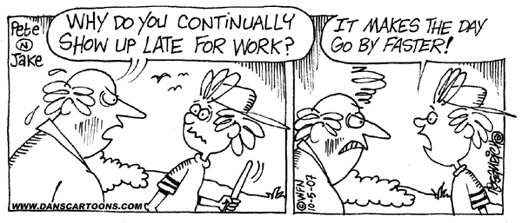

Slide 8
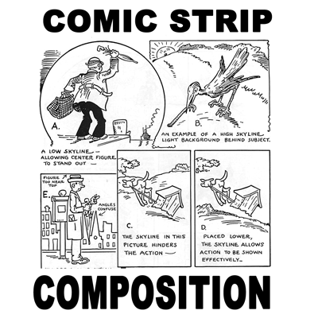
Some More helpful hints…

Slide 9
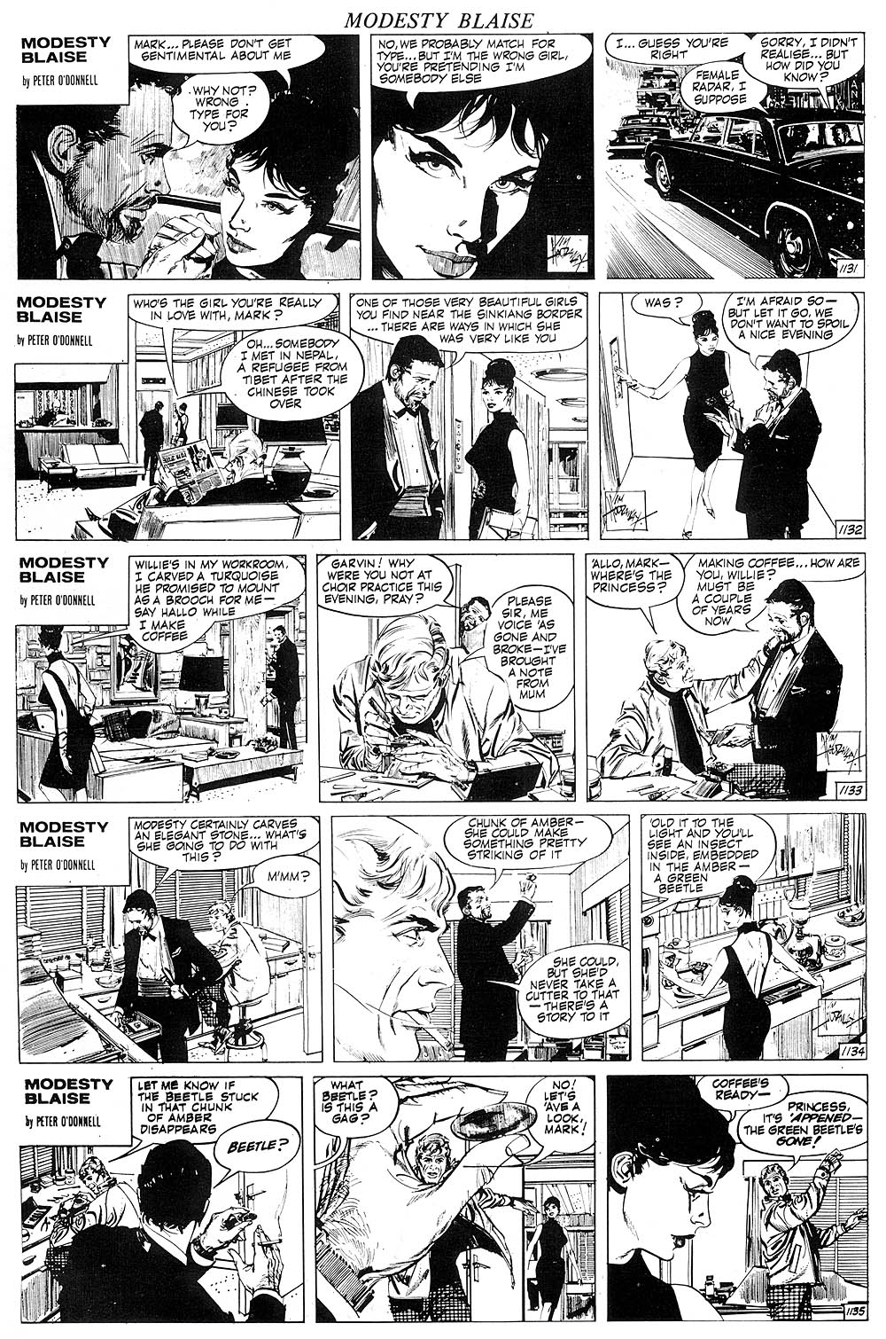

Slide 10
