Slide 1
Photocompositon

Slide 2
Simplicity
Often a photo will lack impact because the main subject is so small it becomes lost among the clutter of its surroundings. By cropping tight around the subject you eliminate the background "noise", ensuring the subject gets the viewer's undivided attention.

Slide 3
Texture
Anything which makes a picture feel more real will cause people to look at it longer. Look for pictures that accentuate the weave of the fabric in someone’s clothing, or sweat, tears or rain on a persons face.

Slide 4
Controlled backgroud
How many times have you taken what you thought would be a great shot, only to find that the final image lacks impact because the subject blends into a busy background? Look around for a plain and unobtrusive background and compose your shot so that it doesn't distract or detract from the subject. Consider a blurred background.

Slide 5
Framing
The world is full of objects which make perfect natural frames, such as trees, archways and holes. By placing these around the edge of the composition you help to isolate the main subject from the outside world. The result is a more focused image which draws your eye naturally to the main point of interest.

Slide 6
Leading Lines
When we look at a photo our eye is naturally drawn along lines. By thinking about how you place lines in your composition, you can affect the way we view the image. Diagonal lines create dynamic compositions, leading lines carry the viewer’s eye into the picture, while repetitive lines draw the viewer’s attention to the center of interest.

Slide 7
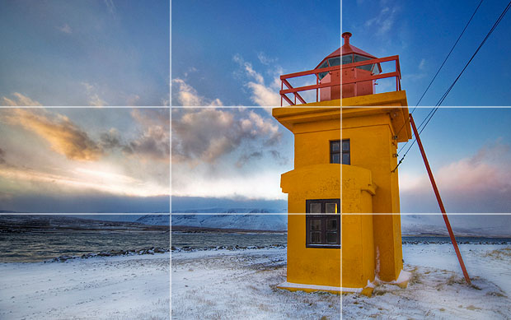
Rule of Thirds
Imagine the image in the picture frame is divided into thirds both horizontally and vertically, creating nine equal segments. The center of interest/most important elements should be placed at the point where these lines intersect.

Slide 8
Viewpoint
Before photographing your subject, take time to think about where you will shoot it from. Our viewpoint has a massive impact on the composition of our photo, and as a result it can greatly affect the message that the shot conveys. Rather than just shooting from eye level, consider photographing from high above, down at ground level, from the side, from the back, from a long way away, from very close up, and so on.

Slide 9
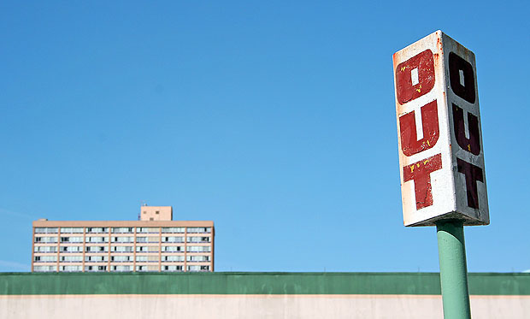
Balance
Placing your main subject off-centre, as with the rule of thirds, creates a more interesting photo, but it can leave a void in the scene which can make it feel empty. You should balance the "weight" of your subject by including another object of lesser importance to fill the space.

