Slide 1
WELCOME BACK!

Slide 2
IN the Name of Jumping Right in, we are going to Spend today creating:
Your Challenge:
Using only Black and White Ink, Fill your page with 300 lines. Yes, 300!! You can do it ☺
You will begin by taping your edges, and making sure you have at least two drawing tools with different thicknesses (ex. A fine and extra fine sharpie, or a micron…or a black pen of your choosing)
Don’t forget to Consider the following…..

Slide 3
LINE QUALITY:
Lines can have a variety of characteristics
Can you remember the 5 types of lines?
Take a minute to draw them in your sketchbook
Now take 2 minutes to fill a page with lines, how can you change their characteristics?
Can you play with weighting and emphasis?

Slide 4
Balance:
All elements in a design have a visual weight. They will also have a visual direction. Learning to control both will lead to greater control over several principles of design, most notably visual balance.
How can you move the viewer’s eye around your piece?
What are the elements that control balance?
Your composition needs to be in balance, whether symmetrical, asymmetrical, or radial. You’ll achieve this balance by placing elements of combined equal visual weight on either side of the optical center
Dominance/Focal Points – Focal points are elements that attract the eye. They’re elements of greater visual weight. The dominant element of a design is the element with the greatest visual weight.

Slide 6
Van Gogh used visual weight and direction to created a balanced composition with a great amount of flow through it.

Slide 8
Remember that visual weight is a measure of how much something attracts your eye. If you keep that in mind some of the factors below will make more sense.
Factor | Effect
Size | Larger objects appear visually heavier than smaller objects
Shape | Objects of regular shape appear heavier than irregularly shaped ones
 | Objects of compact shape are visually heavier than those not compact
Form & Space | Positive forms weigh more than negative space. A large space can be balanced against a smaller positive form.
Isolation | Objects isolated in a space appear heavier than those surrounded by other elements
Density | Packing more elements into a given space gives more weight to that space. Multiple small objects can balance one larger object
Color | Red seems to be heaviest color while yellow seems to be lightest. In general warmer colors appear heavier than cooler colors.
 | High-Intensity colors appear heavier than low-intensity ones. A small area of bright color can counterbalance a larger area of dull neutral color.
Value | A darker object will have more weight than a lighter object. The higher the value-contrast (between object and background), the heavier the weight of the object*
Intrinsic Interest | Complex, intricate, or peculiarly shaped objects appear visually heavier than objects not possessing these features.
Texture | An element with more complex texture is heavier visually than one with a simple textureor no texture at all. A block of text has the quality of a rough texture
Volume | 3-dimensional volumes carry more mass and visual weight than 2-dimensional surfaces
Depth | The greater the depth of field of an area, the greater the visual weight it carries.
Perceived physical weight | An element that looks like a car will appear heavier than an element that looks like a feather.
Location/Position | The visual weight of an object increases in proportion to its distance from the center (or dominant area) of the composition.
 | A large object placed near the center can be counterbalanced by a smaller object placed near the edge
 | An object in the upper part of a composition appears heavier than an object in the lower part.
 | Objects on the right of the composition appear heavier than those on the left
Orientation | Vertical objects appear heavier than horizontal objects. A diagonal orientation carries more visual weight than a horizontal or vertical one.

Slide 9
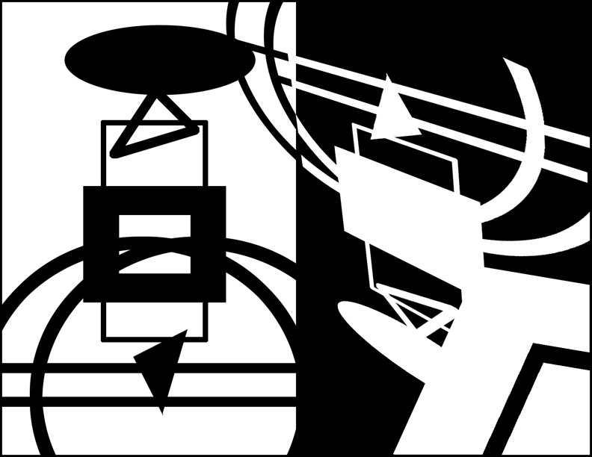
POSITIVE AND NEGATIVE SPACE:

