Slide 1
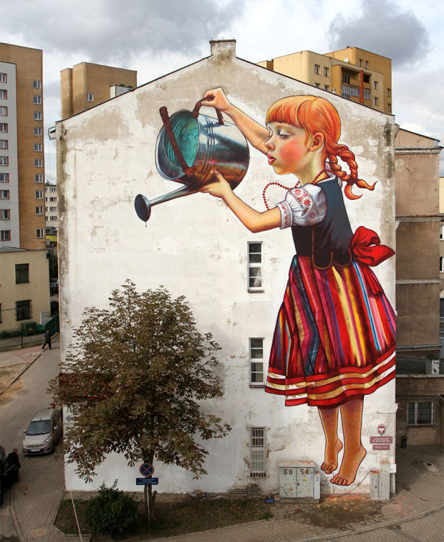
Artists Promote Change

Slide 2
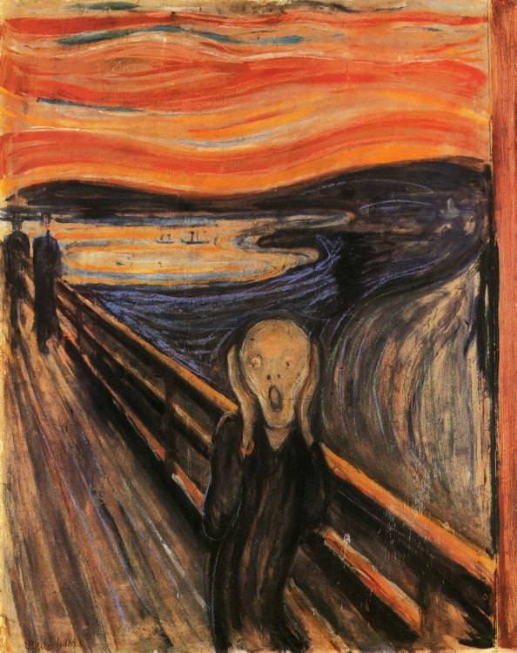
It would be easy for you to dismiss art as excessive, as unnecessary, a waste of money and resources when compared with the destitution, ills and social injustices ever-present around the world. If you did this, you would be missing the point of art.

Slide 5
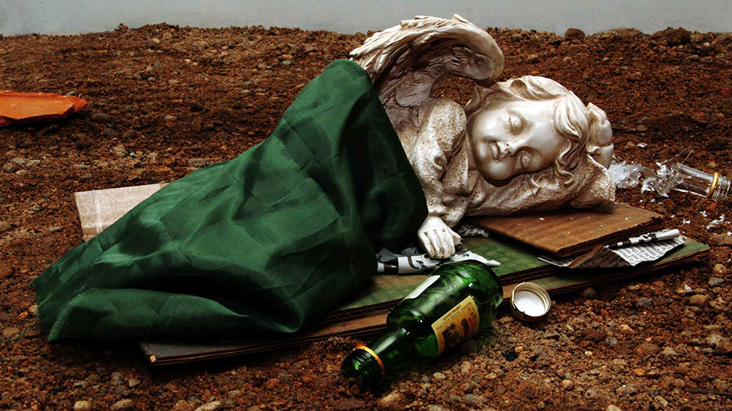
Art exposes and helps resolve issues of social justice. As a cultural tool, art helps humanize and actualize the emotions, grievances, and fears of those who may not have another place to voice concerns. As an illustrative and journalistic tool, art shocks and inspires us to action. What art depicts can illicit a visceral, almost cellular, reaction.

Slide 6
Damien Hirst: ‘The Physical Impossibility of Death in the mind of someone living’ (1991)

Slide 8
Barbara Kruger…

Slide 11
Can Art Change the World?
https://youtu.be/9mSZV-6CwWI Favianna Rodriguez (Artist and Activist)
https://vimeo.com/140237137
http://www.jr-art.net/videos/face-2-face (Street Artist ‘JR’ promotes change in Israel and Palestine )
JR’s photo concept continues to snowball. Have a look how the concept has morphed: https://www.ted.com/talks/jr_one_year_of_turning_the_world_inside_out#t-259980

Slide 12
Can you think of any local artists that promote change in their work?

Slide 13
Meet Lawrence Paul Yuxweluptun…
He graduated from Emily Carr School of Design in 1983 (Honours Degree in Painting)
He liked to document and promote change in contemporary Indigenous history through large Scale Paintings
Incorporated the Coast Salish formal Design Elements
Paintings explore political, Environmental, and cultural issues-

Slide 14
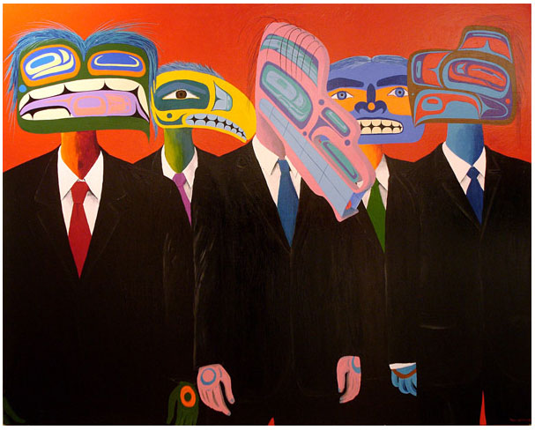
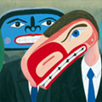
Lawrence Paul Yuxweluptun has created some of the most memorable painted images in the last quarter-century of Canadian art making.
Here are some examples:

Slide 15
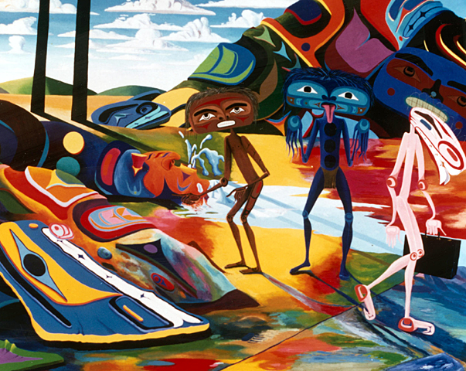
LPY combines Coast Salish design elements with Surrealism

Slide 16
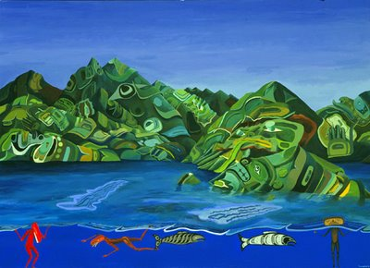
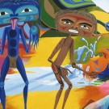
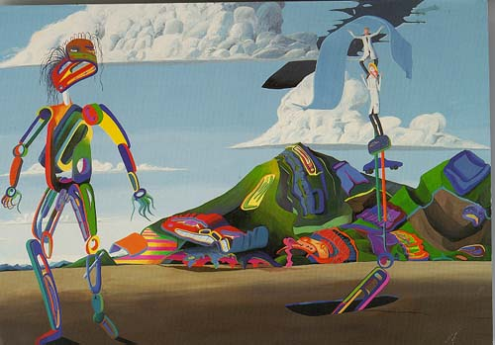
What do these works
have in common?

Slide 17
What are some of the Big idea behind LPY’s work?
suppression of First Nations cultures
the occupation and destruction of the natural environment
self-governance and the politics of land claim negotiations

Slide 18
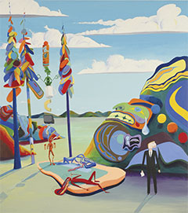
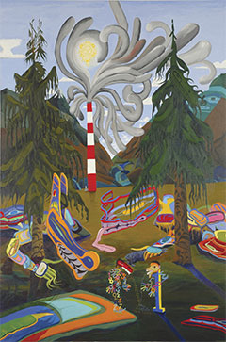

Slide 20
Get out your Sketchbooks…
WHILE YOU WATCH THIS VIDEO, USE YOUR SKETCHBOOK TO DOCUMENT THE COMMON SHAPES USED IN COAST SALISH DESIGN
(yes- DRAW THEM!)
http://Typical Shapes used in Coast Salish Design

Slide 21
Sketchbook Challenge
Use the Coast Salish Design Elements that you just learned about, to create a Coast Salish inspired ’Zentangle’ in your sketchbook
Your Zentangle must take up half the page of one of your sketchbook pages
Don’t forget the major rules of ‘Zentangles’:
While you can draw the initial boundaries in pencil, you must use ink once you begin to draw your designs
Relax, and Enjoy….if you make a mistake, just go with it!

Slide 22
Your Project:
Like the artists in this presentation, your painting must promote change
The catch: You must incorporate the basic Coast Salish Design Elements
Ovals, Trigons, Ovoids, U-Forms etc.
Think:
How will you incorporate Coast Salish Design?
How will you use colour?
Will you limit your colour scheme?
Analagous
Warm vs. Cool
Monochromatic
Complementary
Will your piece have flat colour, or blended colour? What will your brushstrokes look like?
How will you develop your image?
Free hand?
Projection?
Grid system?
Tracing?
Carbon transfer?

Slide 23
Steps:
1) Using a page in your sketchbook brainstorm ideas of possible causes you would like to promote / support in your work
2) Get inspired
How will you best illustrate this cause?
Where will you get your imagery from?
Begin to gather possible sources of imagery (save to a new pinterest board)
3) Get started
What size paper do you need?
Will you require any materials other than acrylics?

